Slide 1
Secure Your ASP.NET WebApi and MVC Applications
Bob Walker
Lead Application Developer - Farm Credit Services of America

Slide 2

About
Developer since 2004
Lead Application Developer for Farm Credit Services of America
Previously worked for TelventDTN (later Schneider Electric), West Corporation, and Sandhills Publishing
Married in 2015
Passions: Software Development, Cycling, Photography
Founder: CodeAperture.io
Twitter: @CodeApertureIO

Slide 3
Goal For Presentation
General Understanding of Security Threats
Tips and Tricks you can apply Monday morning

Slide 4

Farm Credit Services of America
Association in Farm Credit System which started in 1916
Lending institution providing credit to 1/3 of rural America
Types of loans
Budget
Line of Credit
Real Estate
Country Home Loan
My Team is responsible for one of the loan origination systems

Slide 5
Farm Credit is a Target for

Slide 6
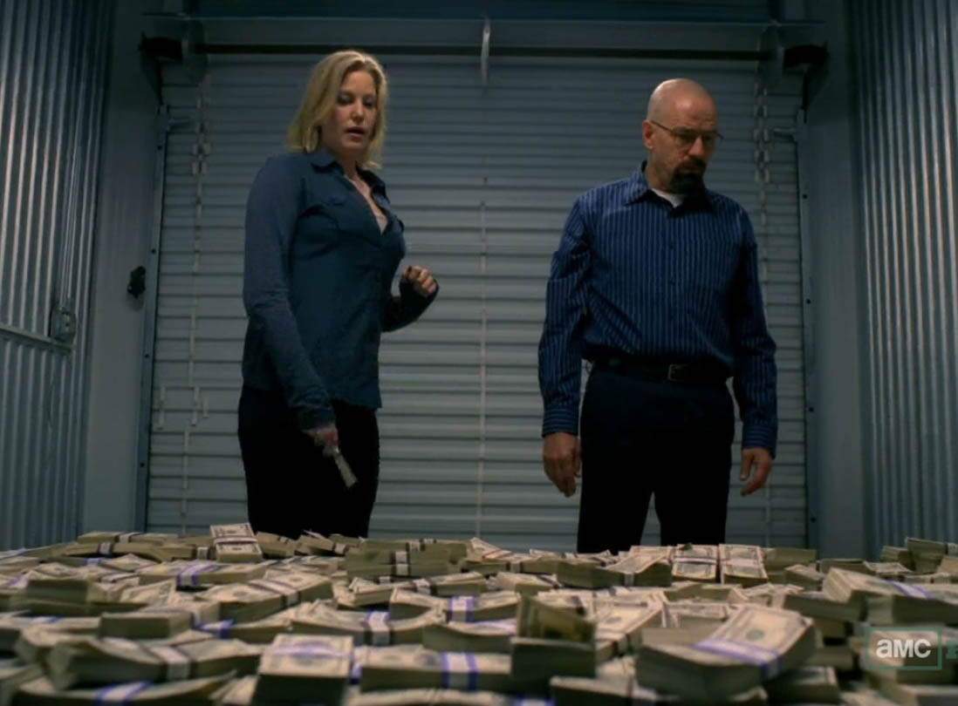
Cash Money

Slide 7
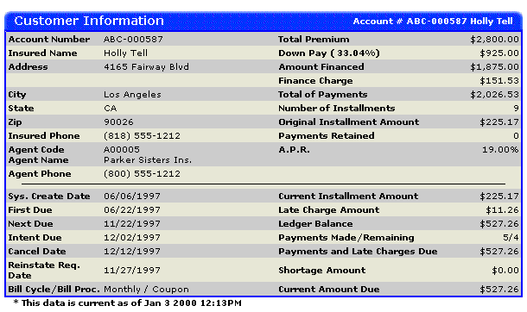
Customer Information

Slide 8
Security is Paramount

Slide 9
100% Security is Impossible

Slide 10
Have realistic security expectations

Slide 11


Slide 12
We Exist to Serve…

Slide 13


Slide 14
But…we shouldn’t trust our users (even employees)

Slide 15
There is a struggle between usability and security

Slide 16
A Realistic Approach to Security…

Slide 17

Layers Of Security
Authentication
Authorization
Data Validation
Content Filters
Action Filters
Encryption
Hashing
Code Reviews
White-Hat Hacking
Code Analysis

Slide 18
Start thinking globally

Slide 19
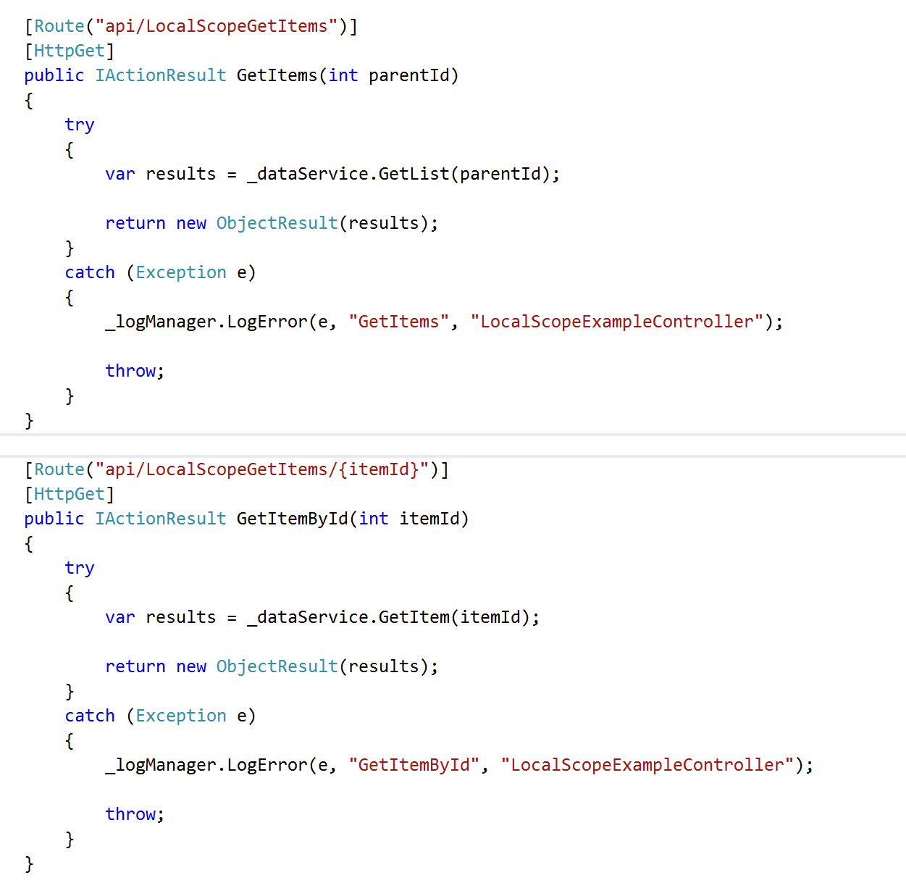

Slide 20
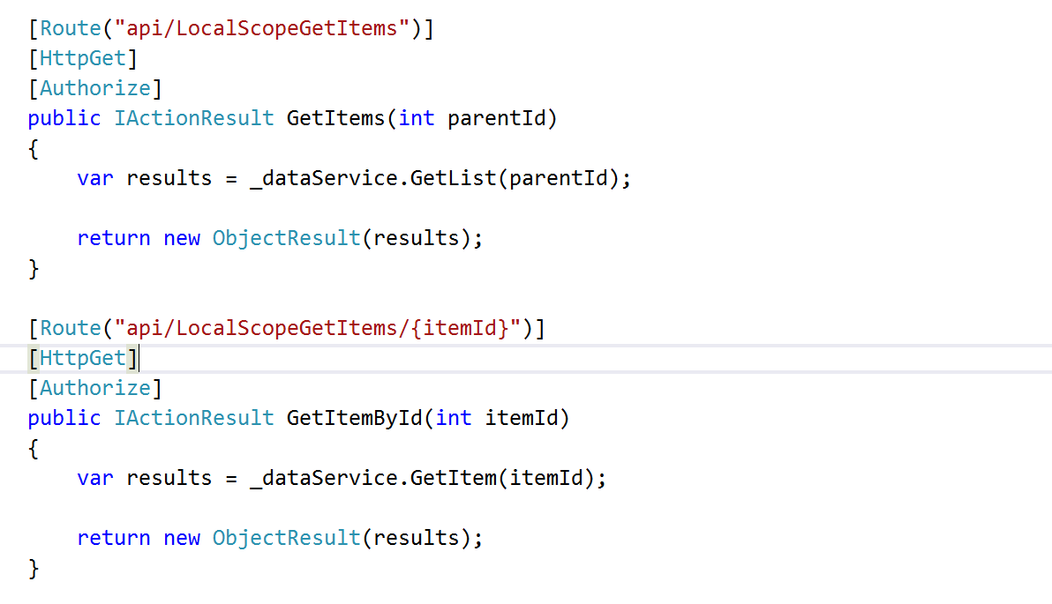

Slide 21
Object Level Security Problems
Developers will forget (we’re human!)
Inconsistency
More code to maintain
Duplicated code

Slide 22
It’s Mathematics
25 WebApi Controllers
x 4 Method Per Controller (CRUD)
= 100 Attributes
50 WebApi Controllers
x 4 Method Per Controller (CRUD)
= 200 Attributes

Slide 23
Application Level Security

Slide 24
Application Level Security Settings
Web.config / App.config
Global.asax
Exception Filters
Action Filters
DbContext (if using Entity Framework)

Slide 25
Cross-Site Scripting Mitigation

Slide 26
Cross-Site Scripting (XSS)
JavaScript is injected into a system
Persistent
Non-Persistent (reflective)
Downloads malicious payload
Sends cookie information (session hijacking)
Keystroke logger
Viruses

Slide 27
Content Security Policy

Slide 28
Content Security Policy
Response Headers
Whitelist of acceptable sources / Blacklist of unacceptable sources
Types
JavaScript
Images
CSS
Websocket
Disables inline CSS, eval function, setTimeout, setInterval, DOM event handlers
Configured in web.config

Slide 29
Content Security Policy Rules Of Thumb
Blacklist everything
Whitelist only accepted sources
Test, test, test
Don’t blindly add

Slide 30
Content Security Policy Demo

Slide 31
AntiXSS Encoder

Slide 32
AntiXSS Encoder
Library Provided by Microsoft
Override Default Encoder
Configured at Web.Config
All Characters not found in the safe list are encoded

Slide 33
AntiXSS Encoder Demo

Slide 34
XSS Leads to Session Hijacking

Slide 35
Session Hijacking
An Attacker using XSS is able to hijack session cookies
Attackers go after credentials for
E-Commerce Sites (Amazon, NewEgg, etc.)
Banking
Email

Slide 36
Cookie Policies

Slide 37
Cookie Policy
HttpOnlyCookies - Any cookie sent from the server cannot be accessed via JavaScript
RequireSSL – Cookies are only sent when accessing SSL side
Configured in web.config

Slide 38
Cookie Policy Demo

Slide 39
SQL Injection

Slide 40
SQL Injection
Attacker Maps an application’s database using a tool like SQLMap
Selects Sensitive Information (SS#, DOB, etc.)
Injects XSS

Slide 41
Exception Information
Same information to debug problems is used by attackers
SQL Exception
Query Ran
Column Name
Table Names
Exception on REST calls
End Point Hit
Parameters
Headers

Slide 42
Exception Filter

Slide 43
Exception Filter
Handles all errors thrown
Logs Error Details for development team
Only Exposes Minimum Information to user
Configured global in the Global.asax file

Slide 44
Exception Filter Demo

Slide 45
Action Filters

Slide 46
Action Filters
Custom Business Logic to enforce security
Can run before or after request is complete
All Action Filters must run before controller method is run
Able to access dependency injector
Configured globally through Global.asax

Slide 47
Help Prevent SQL Injection
Encode Data Coming In
Transform ‘ into ‘’
Ensure Type Safety
Encode HTML
Encode Data Going Out
Encode HTML / JavaScript

Slide 48
Action Filter Demo

Slide 49
Loan Application Action Filter
Loan Cannot Be Edited When
It is in “completed” state
Opened by another user
User is viewing in read-only mode
Throw Exception when user attempts to edit
Be sure to log exception (for auditing!)

Slide 50
Protect Your Database

Slide 51
Configuration
Don’t store username/password in web.config
Don’t grant rights to built in roles for application service account
Grant permissions at schema level
Grant select to dbo
Grant CRUD to custom schema
Use different service accounts per application

Slide 52
Entity Framework
Create context to inherit from dbcontext
Inject custom rules on save changes method
Encode Data Going in to prevent XSS

Slide 53
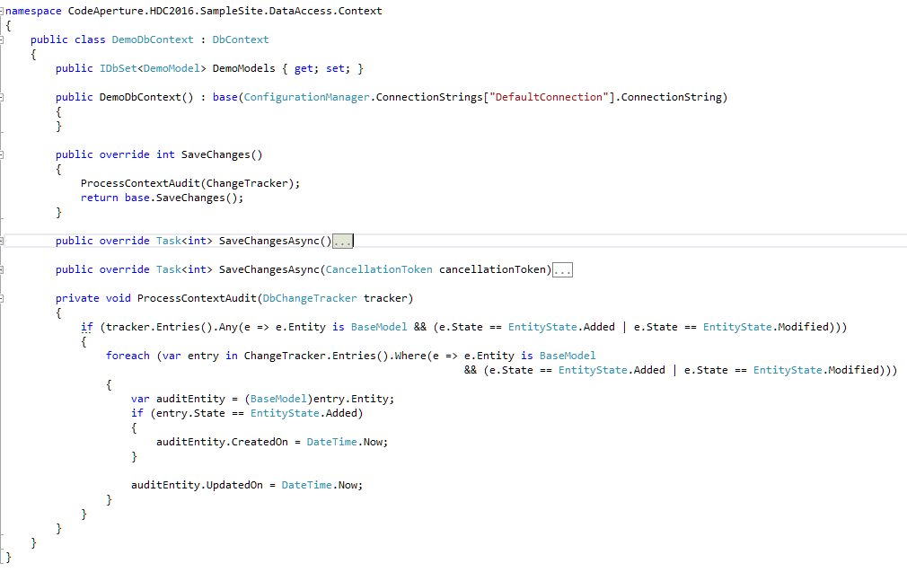

Slide 54
SDLC Improvements

Slide 55
Automated Testing
Security Exploits are often times nothing more than a missing test case
Unit Tests
Service Tests
UI Tests

Slide 56
White-Hat Hacking
Have other developers try to hack your site
Be as evil as you can be
Get permission first!

Slide 57
Code Reviews
Evaluate for possible security flaws
SQL Injection (dynamic SQL)
XSS (reflective and persistent)
Security disabled to support business needs
Object Level Security (try/catch blocks, attributes, etc.)

Slide 58
Create Intrusion Detection Plan

Slide 59
Example Parts of Plan
Intrusion detection
Automated
Manual
Logging
Response
Data Cleanup
Customer Notification
Post Moterm

Slide 60
Don’t Start Plan After Your Compromised

Slide 61
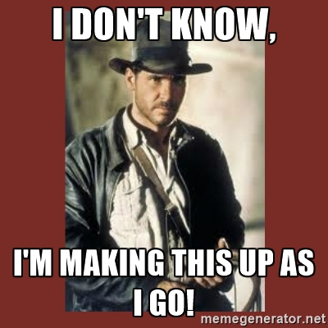

Slide 62
Not all doom and gloom

Slide 63


Slide 64
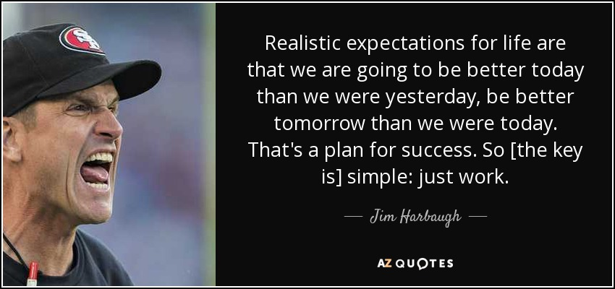

Slide 65
Questions?

Slide 66
Thank you!
Follow @CodeApertureIO
Email: bob.walker@codeaperture.io
Download: https://github.com/CodeAperture/HDC2016

